Slide 1
Prediction of Housing Prices

Slide 2
Problem
Social benefits of homeownership:
Happiness and prosperity
Civic participation
Education
What do prospective buyers look for? Not just price, but also:
Living area
Number of bedrooms
Number of bathrooms

Slide 3
Main Clients
Homebuyers
How much house they’d get for their money
More informed decisions
Businesses
Greater stability
Government officials
Policies that improve housing affordability

Slide 4
About the Data
The data comes from Kaggle
Collected in 2011
80 variables
2,390 properties in Ames, Iowa.

Slide 5
Overview
The steps involved in this analysis include:
Data cleaning and wrangling
Feature engineering
Preprocessing: scaling, one-hot encoding
Exploratory data analysis
Machine learning

Slide 6
Steps in the Analysis
Data Cleaning
Isolate useful values and rename them
Convert values such as “poor” and “good” to numeric
Replace “nan” values with zeros
Feature Engineering
Calculate age: 2011 - year built
Combine half and full bathrooms
First floor + second floor + basement = overall living area

Slide 7
Steps in the Analysis (cont.)
Preprocessing
Scaling
One-hot encoding
Exploratory Data Analysis
Checking for correlations with heatmap
Plotting sale price against other variables
Hypothesis testing

Slide 8
Steps in the Analysis (cont.)
Machine Learning
Run regression analyses using test-train splits

Slide 9
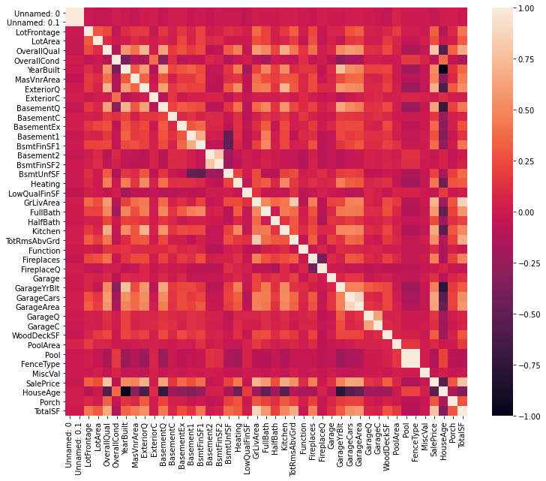
Exploratory Data Analysis
From the correlation heat map, the variables with the most positive correlations are overall quality, kitchen, number of cars that can fit in the garage, and garage area. The variable negatively correlated the most with sale price is the age of the house.

Slide 10
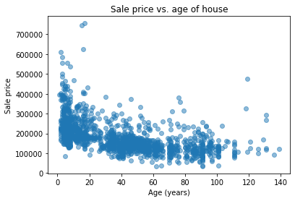
Exploratory Data Analysis (cont.)
Plotting the age of the house against the sale price. Age of the house is negatively correlated with sale price.

Slide 11
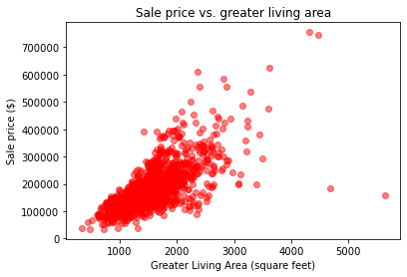
Exploratory Data Analysis (cont.)
Plotting sale price against greater living area A strongly positive correlation can be seen between the living area and sale price.

Slide 12
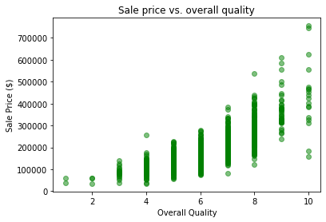
Exploratory Data Analysis (cont.)
Plotting overall quality with sale price. Quality is positively correlated with sale price.

Slide 13
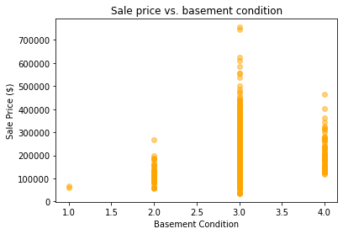
Exploratory Data Analysis (cont.)
Plotting basement condition against sale price. Houses with higher sales prices had basements with condition values of 3.

Slide 14
Machine learning
Comparing different regression models:
Linear Regression
R-squared: 83.6%
Ordinary Least Squares
R-squared: 80.0%
Random Forest Regressor
R-squared: 90.0%
SVM
R-squared: -0.03%

Slide 15
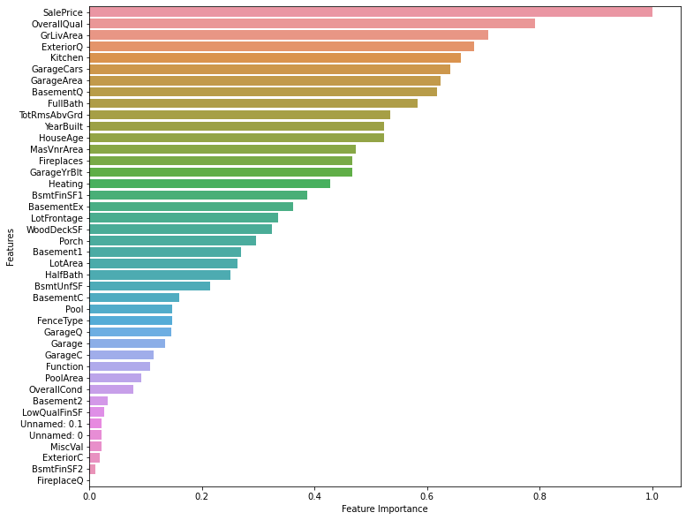
Feature Selection
Strongest features:
Overall quality
Living area
External quality
Kitchen
Garage area

Slide 16
Conclusions
Most important features
Overall quality
Living area
Exterior quality
Kitchen
Garage area

Slide 17
Conclusions (cont.)
Other external factors can influence housing prices:
Geography
Population
Crime rates
Proximity to schools

Slide 18
Future Recommendations
Dataset >10 years old, so more recent data may help.
Data to model after coronavirus pandemic

